Slide 1
VA.Gov Facilities Portfolio - Vet Centers

Slide 2
Digital Experience Product Office (DEPO) Facilities Product Portfolio
Our team is responsible for the stewardship of the VA.gov facilities product portfolio, including the VA.gov Facility Locator product, new VA Medical Center websites (Drupal) product, as well as a main driver of the VA Services Taxonomy.
Facilities Portfolio
Dave Conlon, Product Owner, Dept of Veterans Affairs
Michelle Middaugh, Product Manager, AdHoc
Leyda Hughes, Research & Design, AdHoc
VA.gov
Meg Peters, VA.gov IA & Content Strategy, Dept of Veterans Affairs

Slide 3
Why VA facilities and services matter to Veterans
Veterans associate their VA benefits and health care journey with where they go to receive help and care.
VA facilities humanize VA by demystifying "the VA black box" and by delivering in-person services and support.
Veterans' mental models for VA benefits and health care start with the task they are trying to complete (e.g., get disability benefits), the service they are looking for (e.g., career counseling), or the condition they are experiencing (e.g., depression).

Slide 4
Why this matters to VA
Digital Experience Product Office – VA.GOV
VA has a responsibility to provide accurate VA facilities and VA services information to its customers that align with the Veteran experience of getting and managing their VA benefits and health care.

Slide 5
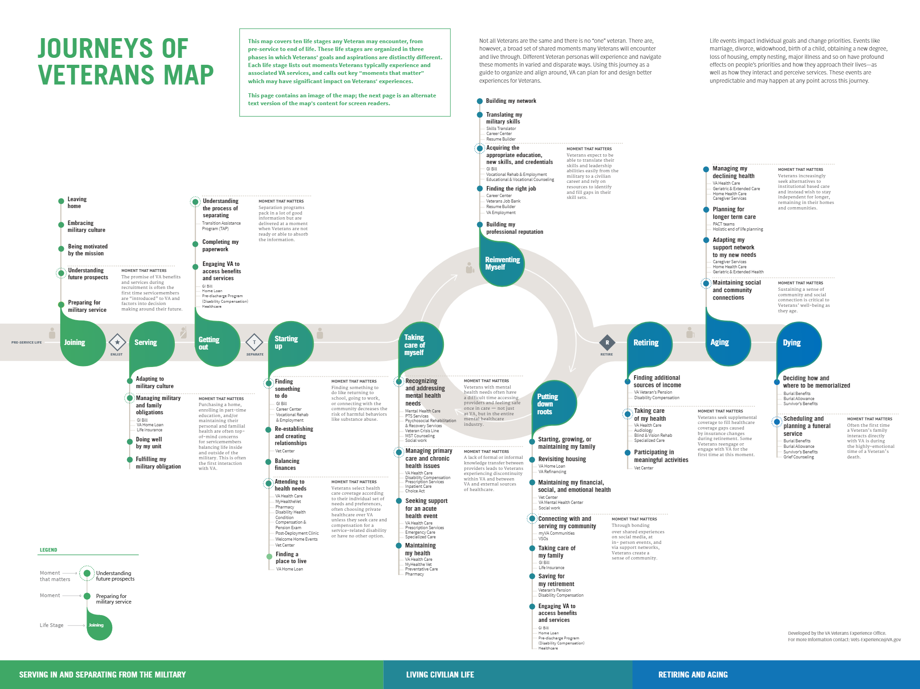
Veteran’s journey
Vet Centers are under-utilized and lack robust digital presence to showcase and connect Veterans with Vet Center benefits/services even through they are or should often be the first touchpoint an active service member and/or family has with the VA.

Slide 6
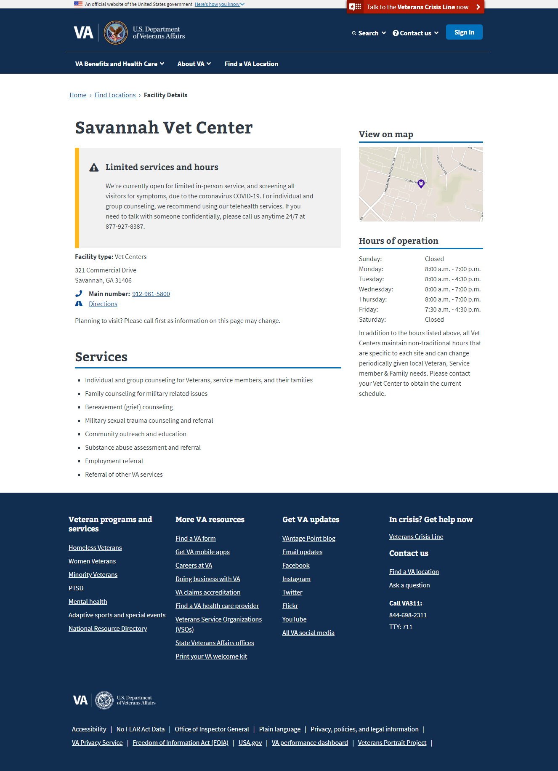
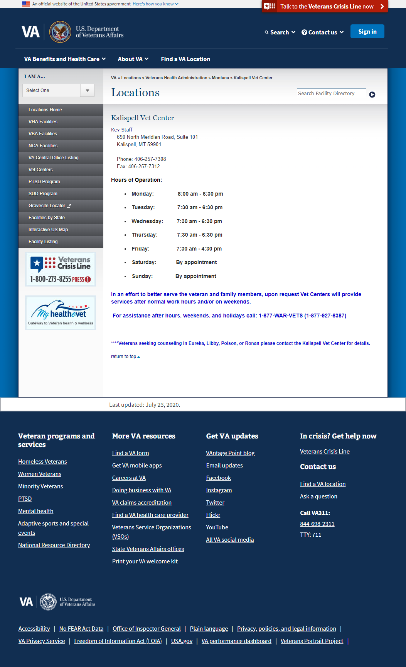
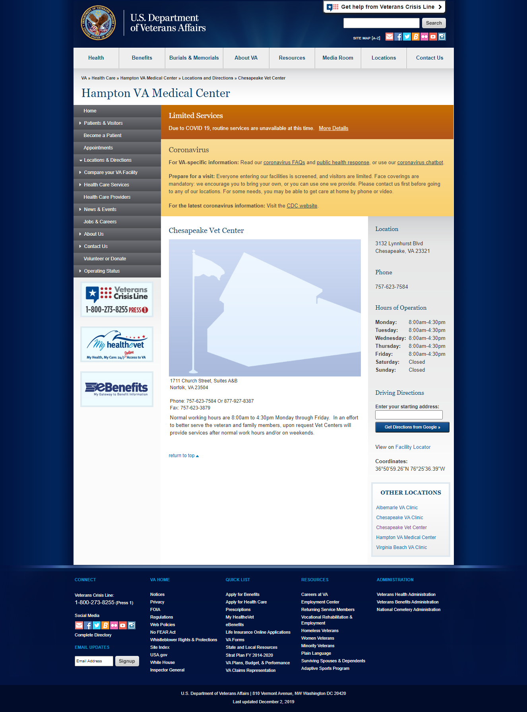
Vet Centers: Current state
Digital Experience Product Office – VA.GOV
VA.gov Facility Locator Detail Pages exist for all Vet Centers with entries in the Lighthouse Facilities API (Facility single-source-of-truth).
Legacy Facility Locator also has detail pages that need to be deprecated
A handful of Vet Centers exist in TeamSite CMS as part of VHA Medical Center websites.

Slide 7
Facilities Vision
Facility-based: Veterans can find all VA and in-VA network facilities based on their current geographical location or another starting/preferred location
Service-based: Veterans can find locations of all VA services based on their current geographical location or another starting/preferred location

Slide 8
Product goals
Facilities products drive users to services
Services products drive users to facilities
Veteran needs (“conditions”) drive users to both facilities and services
Facilities and services products drive users to benefits content and tools
Facilities and services products directly map to touch points in the Veteran journey(s)

Slide 9
How Vet Centers fit in – how we will do it
Work with Veterans to develop a veteran-facing, living, service & “conditions” taxonomy of services available at Vet Centers
Build and publish new Vet Center Facility Prototype
Live at its own URLs outside the Facility Locator
Fit the needs of veterans
Connects veterans with the specific services for his/her needs/ “conditions”
Map to the Veteran’s journey
Fit with the organization’s needs & capabilities
Scale prototype to additional Vet Centers

Slide 10
Partnerships & research – Focus on the Veteran
Design with Veterans, not for them
Virtual and (hopefully) in-person research sessions at Vet Centers to develop a product that meets their needs and understanding.
Work directly with veterans to understand the drivers for their visit(s)
Ensure that we focus the website on the veterans’ needs, interests, and top tasks
Key: Meet the veteran where they are at

Slide 11
Partnerships & research – Don’t neglect the editor!
Design with maintainers, not for them
Work with Central Office and the Field, as appropriate, to determine how we can build and continue to improve a product that meets their needs as maintainers
Ensure that the product and content/data are sustainable and maintainable
The editorial experience needs to meet the content maintainer’s mental model(s)
Meet the editors where they are at!

Slide 12
Timeline
August-September 2020
Services Taxonomy
Research Strategy Development
October 2020-Early 2021
Veteran Research & Synthesis
Editorial Research & Synthesis
Prototype Development – Minimum Viable Product (MVP)
Early to Mid 2021 – Scaled deployment to all Vet Centers

Slide 13
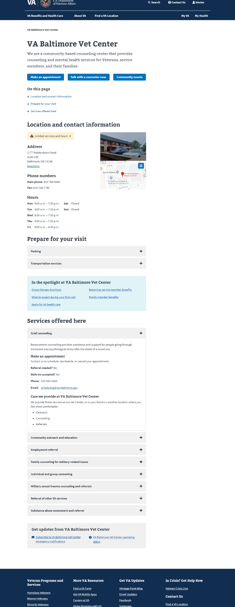
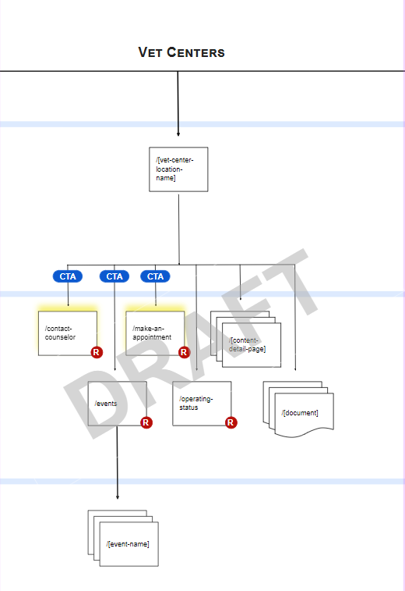
Current noodling – We need research!
Based on work done for the VA Medical Center upgrade project, Andy Lewandowski (USDS) gave us some great initial thoughts.
We need to engage with veteran research specific to Vet Centers and organizational needs for Vet Centers to validate these ideas and establish new ones—but it’s a great place to start!

